Slide 1
Optimizing Web Search for Learning
Incorporating Keyword Density as a Retrieval Objective
Rohail Syed
Kevyn Collins-Thompson

Slide 2
Background
Web search commonly used as starting point for learning tasks
Current ranking algorithms not designed to optimize learning utility
Little existing work on Intelligent Tutoring Systems (ITS) applied to general web search

Slide 3
General ITS Framework
Student wants to learn subject X
Expert determines set of questions to test knowledge of X
Tutor determines resources for student to perform best on test
  Our focus. What web search algorithm optimizes the student’s future test scores.

Slide 4
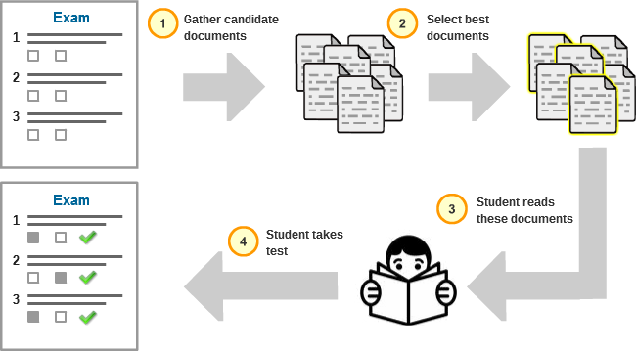
ITS Framework
Icon credit: http://thumb10.shutterstock.com/photos/thumb_large/255466/111580295.jpg

Slide 5
Expert Model
Expert selects set of documents that are most representative of the topic that needs to be taught.
In this study, Expert chose documents manually. Future work will use an automated selection procedure.

Slide 6

Tutor Model
Tutor’s objective is to teach the student a set of N topic-relevant vocabulary terms (keywords)
These are determined using a weighted term-frequency measure on the Expert documents

Slide 7
Tutor Model (Cont’d)
Construct multinomial of weights W based on keyword frequency in Expert corpus.
Our model assumes students are Bayesian learners.
  Need to determine how to distribute T total keywords amongst the N keywords. Ideally T = ∞
  So, we assign the student to read S_{i} = W_{i} * T instances of the i^{th} keyword.

Slide 8
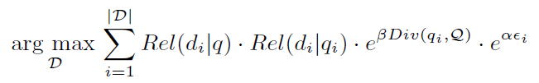
Objective Function
Intrinsic Diversity objective^{[1]}:
ID objective + keyword density penalty

Slide 9
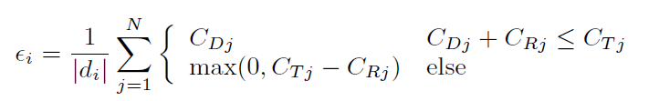
Keyword density parameter
C_{Dj} = instances of j^{th} keyword in D
C_{Rj} = total instances of j^{th} keyword seen so far
C_{Tj} = total instances of j^{th} keyword required to be seen

Slide 10
Study Design
Crowdsourced study (using CrowdFlower)
  Five topics tested with four levels of α [0,80,120, ∞]. Each condition assigned 35 participants
  Participants: (1) complete pre-reading test (2) read provided documents (3) complete post-reading test
  Learning gain = sum of improvement in scores for each keyword

Slide 11
Results
Mean learning gains per condition and topic
Topics | α = 0 | α = 80 | α = 120 | α = infty | p-value
Igneous rock | 1.312 | 1.094 | 1.333 | 1.529 | p=.562
Tundra | 1.406 | 1.829 | 1.800 | 1.514 | p=.346
DNA | 1.481 | 1.576 | 1.438 | 1.483 | p=.977
Cytoplasm | 1.719 | 3.067 | 1.286 | 1.333 | p<.001***
GSM | 1.654 | 2.478 | 1.258 | 1.967 | p=.0126*
Signif. codes: 0 `***' 0.001 `**' 0.01 `*' 0.05 `.' 0.1 ` ' 1

Slide 12
Results
Mean learning gains per 1000 words read per condition and topic
Topics | α = 0 | α = 80 | α = 120 | α = infty | p-value
Igneous rock | 0.149 | 0.106 | 0.168 | 0.312 | p<.001***
Tundra | 0.091 | 0.201 | 0.137 | 0.232 | p<.001***
DNA | 0.203 | 0.207 | 0.168 | 0.261 | p=.258
Cytoplasm | 0.516 | 0.857 | 0.320 | 0.381 | p<.001***
GSM | 0.173 | 0.312 | 0.216 | 0.517 | p<.001***
Signif. codes: 0 `***' 0.001 `**' 0.01 `*' 0.05 `.' 0.1 ` ' 1

Slide 13
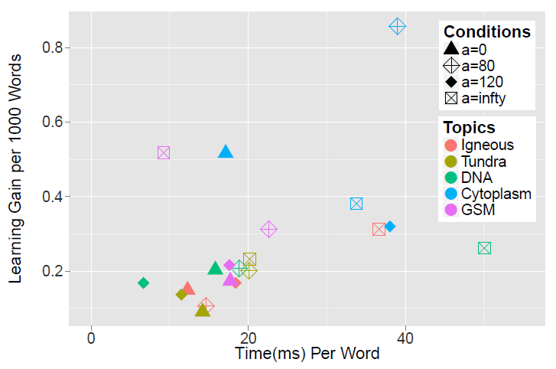
Learning Per Word vs Time Per Word

Slide 14
Conclusion
We construct objective function in ITS setting to optimize learning gains.
We find early evidence that keyword density objective can improve actual learning.
We consider importance of incorporating other media types in objective function.

Slide 15
References
Raman K., Bennett P. N., and Collins-Thompson K. 2013. Toward Whole-session Relevance: Exploring Intrinsic Diversity in Web Search. In Proceedings of the 36th International ACM SIGIR Conference on Research and Development in Information Retrieval (SIGIR '13). ACM, New York, NY, USA, 463-472.
De Angeli A., Coventry L., Johnson G., and Renaud K. 2005. Is a picture really worth a thousand words? Exploring the feasibility of graphical authentication systems. International Journal of Human-Computer Studies 63, 1 (2005), 128-152.

Slide 16
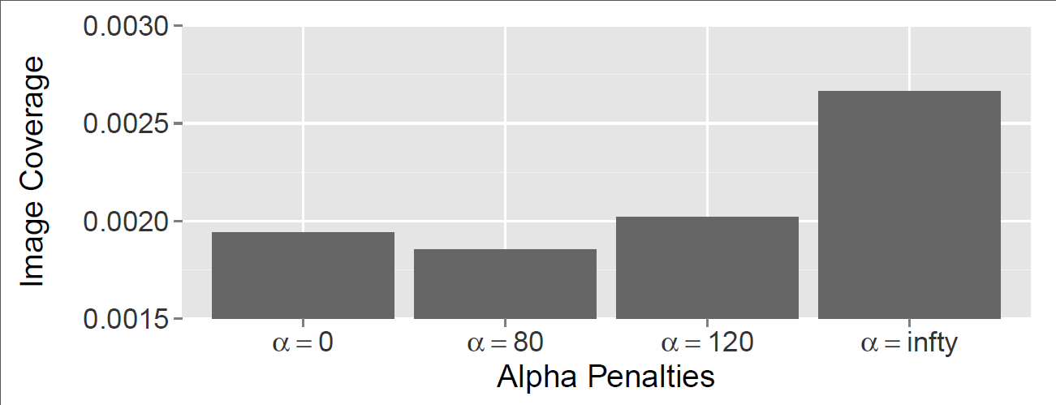
Other Results
Consider possible interaction of pictures in learning process
  Picture superiority effect^{[2]}. We were testing “Remember” learning (vocabulary learning)
  Higher α conditions had higher image coverage

